Slide 1
Chapter 15 Air around us. (Notes)

Slide 2
What is the composition of air?
Air is a mixture of gases, water vapour and dust particles. Largely, it consists of
Nitrogen (78%)
Oxygen (21%)
Carbon dioxide (0.03%)
Other gases like helium, hydrogen, argon etc.(0.17%)
Water vapour and dust particles.

Slide 3
2. Which gas in the atmosphere is essential for respiration?
Oxygen is essential for respiration.
3. How will you prove that air supports burning?
Fix two small candles of the same size in the middle of two shallow containers. Now, fill the containers with some water. Light the candles and then cover each one of them with an inverted glass(one much taller than the other) observe carefully.
The candles get extinguished. After few minutes,we will observe decrease in volume by 1/5th of volume of the jar.
This decrease in the volume is equal to the quantity of oxygen in the air inside the jar.
Burning can occur only in the presence of oxygen. We see that one component of air is oxygen. Now, the amount of air and hence its oxygen component inside each glass in our experiment, is limited. When most of this oxygen is used up by the burning candle, it can no longer burn and blows out. Also,water rises up in the glass once the candle blows out. However,this in water level should not be associated with the amount of oxygen utilised in burning of the candle. Hence, air containers some amount of oxygen.

Slide 4
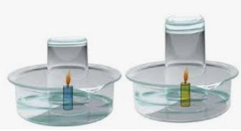

Slide 5
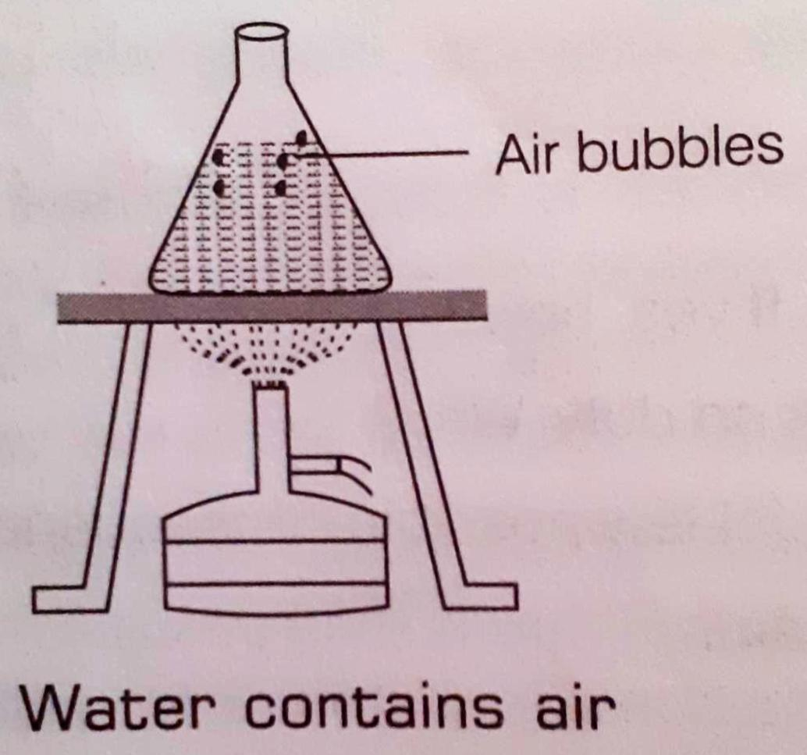
4. How will you show that air is dissolved in water?
Take some water in a glass vessel or breaker. Heat slowly on a tripod stand well before the water begins to boil. Look carefully at the inner surface of the vessel, you will see tiny bubbles inside. These bubbles come from the air dissolved in water.

Slide 6
5. Why does a lump of cotton wool shrink in water?
Lump of cotton wool has air among gaps of cotton fibres. When dipped in water, air from these gaps is replaced by water. The cotton lump becomes heavy and also shrinks due to removal of air gaps.
6. The layer of air around the earth is known as …….
Atmosphere
7. The component of air used by green plants to make their food, is ………
Carbon dioxide

Slide 7
8. List five activities that are possible due to presence of air.
Respiration by animals.
Photosynthesis by plants.
Power generation by windmills.
Burning of fuels and substances.
Movements of sailing yachts, gliders, parachutes and aeroplanes.

Slide 8
9. How do plants and animals help each other in the exchange of gases in the atmosphere?
There is an interdependence of plants and animals on each other for exchange of gases. Plants take carbon dioxide from the atmosphere and prepare food. This is called photosynthesis. During this process, plants give out oxygen to the atmosphere. Animals inhale this oxygen and gives out carbon dioxide to the atmosphere. Therefore, plants and animals help each other in the exchange of gases in the atmosphere.

